Slide 1
Mobile & Wireless Technology CT090-3-2 & Version VD01
Other Current Technologies

Slide 2
Topic & Structure of The Lesson
Other current technologies
Bluetooth
NFC (Near Field Communication)

Slide 3
Learning Outcomes
At the end of this topic, You should be able to
Understand Bluetooth and its architecture
Be familiar with NFC (Near Field Communication)

Slide 4
Key Terms You Must Be Able To Use
If you have mastered this topic, you should be able to use the following terms correctly in your assignments and exams:
Piconet
Scatternet
RFID
NFC Chips

Slide 5
Bluetooth – Why is it called Bluetooth?
Harald Bluetooth was king of Denmark in the late 900s. He managed to unite Denmark and part of Norway into a single kingdom then introduced Christianity into Denmark.
He left a large monument, the Jelling rune stone, in memory of his parents. He was killed in 986 during a battle with his son, Svend Forkbeard.
Choosing this name for the standard indicates how important companies from the Nordic region (nations including Denmark, Sweden, Norway and Finland) are to the communications industry, even if it says little about the way the technology works.

Slide 6
Bluetooth – What is Bluetooth?
A cable-replacement technology that can be used to connect almost any device to any other device.
Bluetooth can connect up to eight devices simultaneously. With all of those devices in the same 10-meter (32-foot) radius, you might think they had interfere with one another, but it is unlikely.
Bluetooth uses a technique called spread-spectrum frequency hopping that makes it rare for more than one device to be transmitting on the same frequency at the same time. In this technique, a device will use 79 individual, randomly chosen frequencies within a designated range, changing from one to another on a regular basis.

Slide 7
Bluetooth – What is Bluetooth?
In the case of Bluetooth, the transmitters change frequencies 1,600 times every second, meaning that more devices can make full use of a limited slice of the radio spectrum.
Since every Bluetooth transmitter uses spread-spectrum transmitting automatically, it is unlikely that two transmitters will be on the same frequency at the same time.
This same technique minimizes the risk that portable phones or baby monitors will disrupt Bluetooth devices, since any interference on a particular frequency will last only a tiny fraction of a second.

Slide 8
Bluetooth – Architecture
When Bluetooth - capable devices come within range of one another, an electronic conversation takes place to determine whether they have data to share or whether one needs to control the other.
The user does not have to press a button or give a command -- the electronic conversation happens automatically. Once the conversation has occurred, the devices -- whether they are part of a computer system or a stereo -- form a network.
Bluetooth communication occurs between a master radio and a slave radio. Bluetooth radios are symmetric in that the same device may operate as a master and also the slave. Each radio has a 48-bit unique device address (BD_ADDR) that is fixed.

Slide 9
Bluetooth – Architecture
Two or more radio devices together form ad-hoc networks called piconets. All units within a piconet share the same channel. Each piconet has one master device and one or more slaves.
There may be up to seven active slaves at a time within a piconet. Thus, each active device within a piconet is identifiable by a 3-bit active device address. Inactive slaves in unconnected modes may continue to reside within the piconet.
A master is the only one that may initiate a Bluetooth communication link. However, once a link is established, the slave may request a master/slave switch to become the master.

Slide 10
Bluetooth – Architecture
Slaves are not allowed to talk to each other directly. All communication occurs within the slave and the master. Slaves within a piconet must also synchronize their internal clocks and frequency hops with that of the master.
Each piconet uses a different frequency hopping sequence. Radio devices used Time Division Multiplexing (TDM). A master device in a piconet transmits on even numbered slots and the slaves may transmit on odd numbered slots.
Multiple piconets with overlapping coverage areas form a scatternet. Each piconet may have only one master, but slaves may participate in different piconets on a time-division multiplex basis.

Slide 11
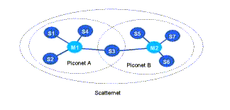
Bluetooth – Architecture
A device may be a master in one piconet and a slave in another or a slave in more than one piconet.

Slide 12
NFC – What is NFC?
NFC is a method of wireless data transfer that detects and then enables technology in close proximity to communicate without the need for an internet connection. It's easy, fast and works automagically.
The tech involved is deceptively simple. Evolved from radio frequency identification (RFID) tech, an NFC chip operates as one part of a wireless link. Once it is activated by another chip, small amounts of data between the two devices can be transferred when held a few centimeters from each other.

Slide 13
NFC – How NFC is used right now?
At its core, NFC works to identify us by our enabled cards and devices (and by extension, our bank accounts and other personal info.)
How NFC is used right now?
NFC chips stocked inside credit cards for contactless payments is nothing new. But a more recent and admittedly more enticing use case for NFC is with your smartphone, which can digitize your entire wallet.
Virtually every mobile OS maker has their own apps that offer unique NFC functionality.

Slide 14
NFC – How NFC is used right now?
Android users have the widest variety to choose from. First off, US users can nab Google Wallet, which accesses your funds for contactless payments. Samsung Pay, which operates similarly, is on the way for Samsung phone users in US and Korea this Summer.
However, a feature that all Android owners have been able to enjoy is called Android Beam. It was implemented in Ice Cream Sandwich 4.0 as a nifty, simple process that allows for the transfer of photos, contacts and directions that works by holding two phones together.

Slide 15
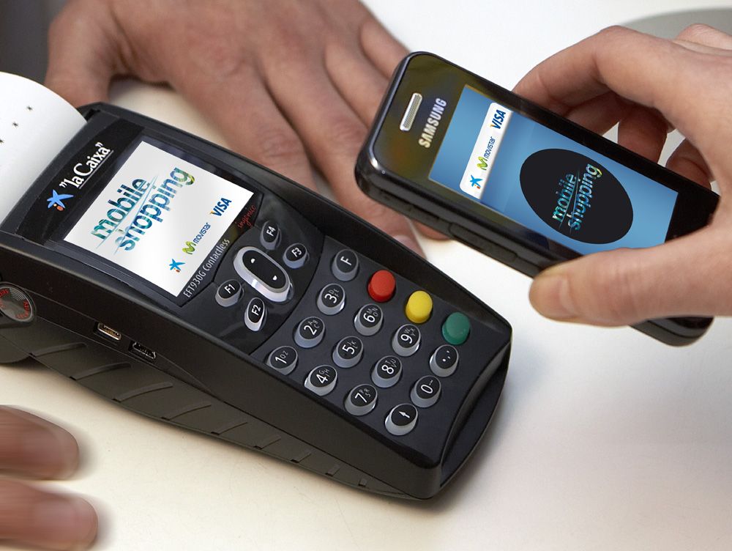
NFC – How NFC is used right now?

Slide 16
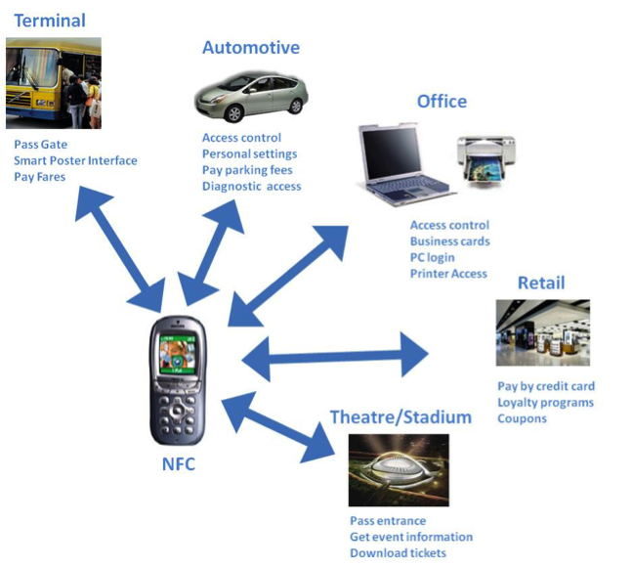
NFC – How NFC is used right now?

Slide 17
NFC – How NFC is used right now?
Apple's iPhone 6 and iPhone 6 Plus received NFC functionality, although with limited use so far, only for Apple Pay. It's a lot like Google Wallet, in that it's an app which gives users the ability to pay for goods and services at participating retailers.
Lastly, those who prefer Microsoft's Windows Phone will be able to use Microsoft Payments when it launches likely around the launch of Windows 10.
Whichever device you have, it's likely that a local supermarket, train station, taxi or coffee shop supports contactless payments via your phone's NFC chip. Go try it out! Simply hold it close to a contactless payment terminal and instantly, like swiping a credit card, the payment will complete.

Slide 18
NFC – How NFC is used right now?
Looking toward the future, it's possible that NFC chips could be used to replace every card in your wallet. That means the unique info on your frequent shopper loyalty cards, library card, business cards and the like could be contained and transmitted simply via NFC.

Slide 19
Quick Review Question
What is Bluetooth? Explain its architecture.
What is NFC? How it works?

Slide 20
Summary of Main Teaching Points
Discussed Bluetooth and its architecture
Discusses NFC and its applications

Slide 21
Question and Answer Session
Q & A

Slide 22
What we will cover next
The Future: Li-Fi
Light fidelity (Li-Fi): towards all-optical networking
LiFi internet (2015): First real-world usage boasts speed 100 times faster than WiFi

